Slide 1

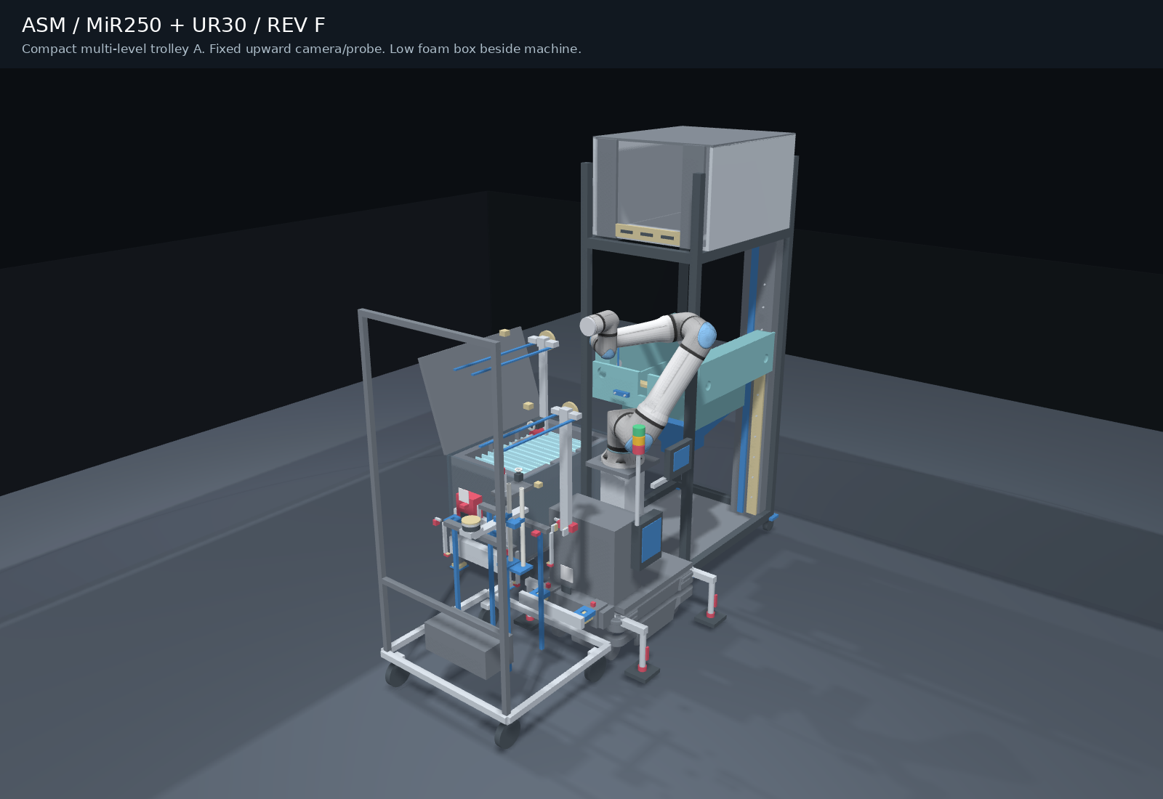
Quartz chamber installation
Quartz chamber
installation
MiR250 + UR30
Compact tool trolleys
Fixed upward metrology
INITIAL CONCEPT FOR DISCUSSION
AETEC / ASM · Revision F · 24 October 2026
01
Notes:
Detailed design remains to be agreed. The fixed robot POC is proposed before mobile integration.
Source: Information for AETEC_20261023.pptx, all 10 slides reviewed. Latest project instructions define Rev F. Initial concept for discussion. Sensing is simulated.

Slide 2
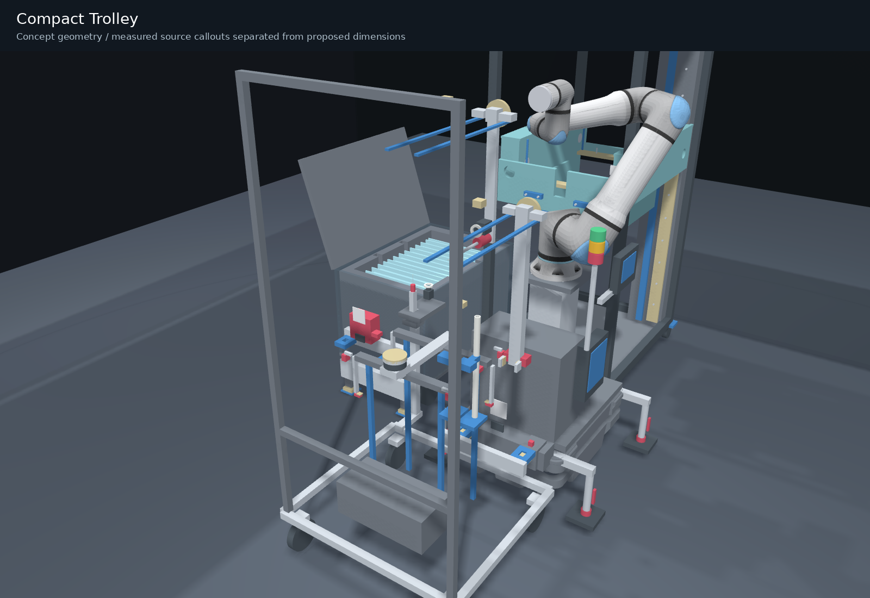
Compact multi-level trolley A
Use vertical height and side access
T1 and optional T3 occupy upper nests. T2 uses the open lower level. Consumables sit in a drawer.
UR30 remains on MiR250. A proposed lift/latch captures the independent trolley.
AETEC / ASM · Revision F · 24 October 2026
02
Notes:
Rack nominal frame935 mm wide,835 mm deep,2090 mm high. Mounted metrology and tool overhang enlarge its operating envelope. Layout is a compact checked candidate, not a global minimum-area proof. Manufacturer acceptance of the custom mobile combination remains open.
Source: Information for AETEC_20261023.pptx, all 10 slides reviewed. Latest project instructions define Rev F. Initial concept for discussion. Sensing is simulated.

Slide 3
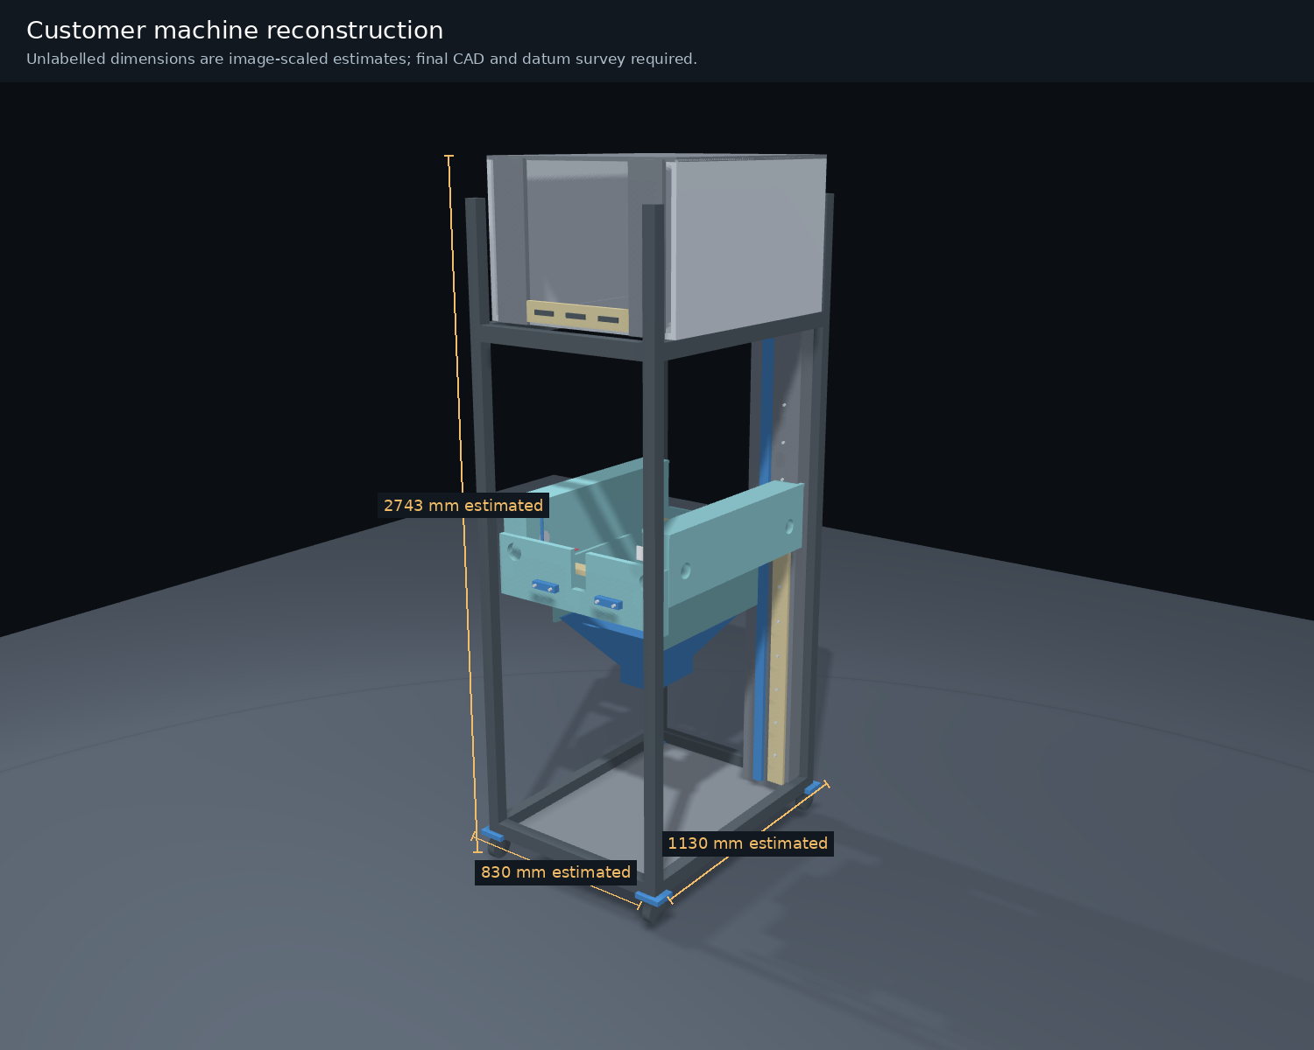
Machine dimensions and source confidence
Reference | mm / status
Type 1 fin envelope | 759 x 490 x 159 Customer callout
Pin / guide spans | 700 / 310 / 450 Customer callouts
Frame envelope | 830 x 1130 x 2743 Image-scaled estimate
Pin / hole diameters | 8 / 10 assumed Fit confirmation required
Perspective scaling cannot establish hidden geometry or tolerances.
AETEC / ASM · Revision F · 24 October 2026
03
Notes:
Original tong and both manual guide STEP files are retained unchanged. Tube diameter34mm and reference355mm. Confirm the complete source datum scheme.
Source: Information for AETEC_20261023.pptx, all 10 slides reviewed. Latest project instructions define Rev F. Initial concept for discussion. Sensing is simulated.

Slide 4
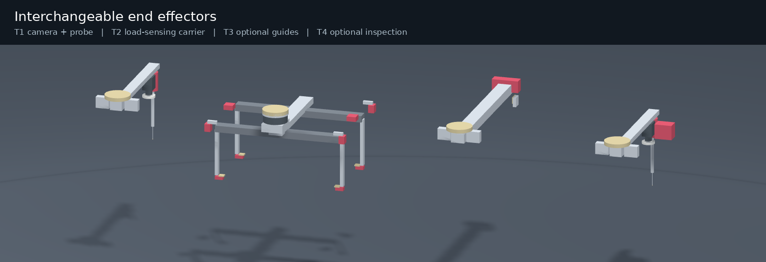
Tools and selectable functions
Tool | Function
T1 standard | Camera first, then low-force contact probing
T2 standard | Fin-slot carrier with independent force and pad-load sensing
T3 option | Small gripper for two removable Teflon guiding fixtures
T4 option | Camera, probe and laser triangulation on trolley B
AETEC / ASM · Revision F · 24 October 2026
04
Notes:
Tool IDs, positive latch, services, nest support and retained-load state must agree before exchange. T3 and guides are optional, excluded from the base trajectory.
Source: Information for AETEC_20261023.pptx, all 10 slides reviewed. Latest project instructions define Rev F. Initial concept for discussion. Sensing is simulated.

Slide 5
Camera views before contact probing
01 Source quartz
View the chamber and foam slots, then touch approved reference surfaces.
02 Three machine pins
Camera views establish the approach. Probing resolves pin centres, heights and three seating-plane references.
03 Parked T2 carrier
View and probe the tool-nest datum before exchanging T1 for T2.
Calibrate hand-eye, probe TCP, stylus radius and tool-change repeatability.
AETEC / ASM · Revision F · 24 October 2026
05
Notes:
Camera/probe cross-checks do not automatically create safety-rated redundant channels. UR30 built-in F/T accuracy10N requires an external precision contact solution for this task. https://www.universal-robots.com/manuals/EN/HTML/SW5_25/Content/prod-usr-man/complianceUR30/H_g5_sections/appendix_g5/tech_spec_UR30.htm
Source: Information for AETEC_20261023.pptx, all 10 slides reviewed. Latest project instructions define Rev F. Initial concept for discussion. Sensing is simulated.

Slide 6
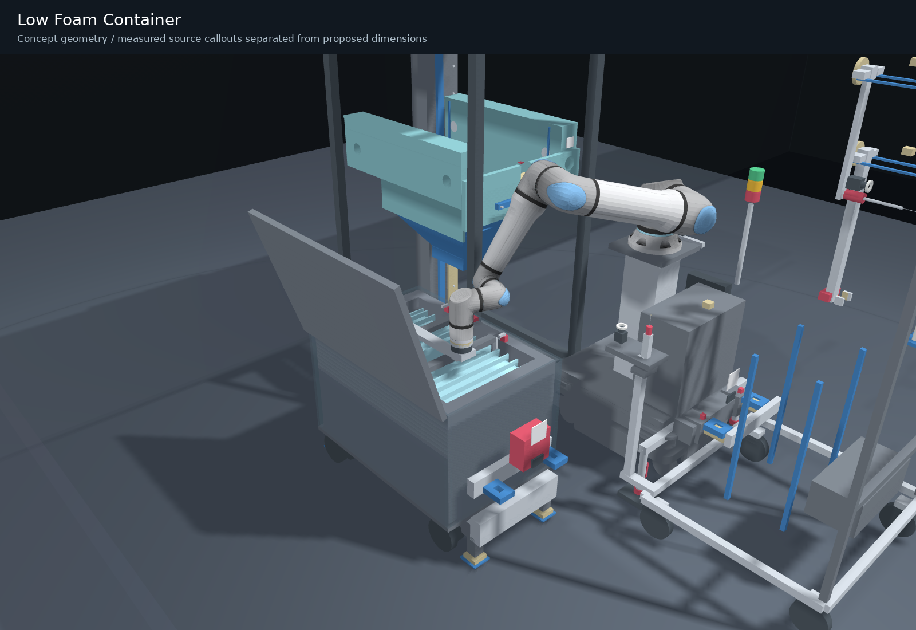
Low foam container and controlled extraction
150 mm caster wheels
A separate located holder transfers box weight to floor stands. Casters are unloaded during pickup; the fin slots remain accessible.
Retained HOLD if stuck
Monitor weight, force and moments during slow breakaway. Do not automatically pull harder.
AETEC / ASM · Revision F · 24 October 2026
06
Notes:
The holder is separate from the low container. No force on the tubulation. Foam dimensions, friction and slot clearances remain trial inputs. Load-carrying contacts must be approved for actual quartz.
Source: Information for AETEC_20261023.pptx, all 10 slides reviewed. Latest project instructions define Rev F. Initial concept for discussion. Sensing is simulated.

Slide 7
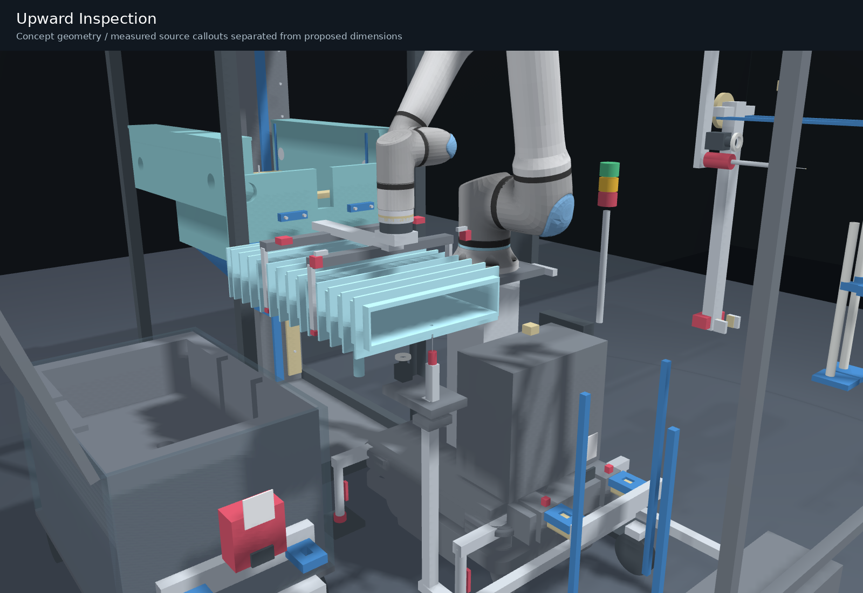
Fixed upward camera and fixed probe
The robot moves the chamber
Both sensors remain rigidly mounted on trolley A. Present each of the three holes and the bottom plane to them.
Clear the stylus and tube before each large transfer. Compare the measured hole pattern with the pin pattern.
AETEC / ASM · Revision F · 24 October 2026
07
Notes:
No XYZ metrology stage. Fixed upward station transform is invariant during measurement. Clearances are nominal; physical uncertainty and low-force probe limits require trials.
Source: Information for AETEC_20261023.pptx, all 10 slides reviewed. Latest project instructions define Rev F. Initial concept for discussion. Sensing is simulated.

Slide 8
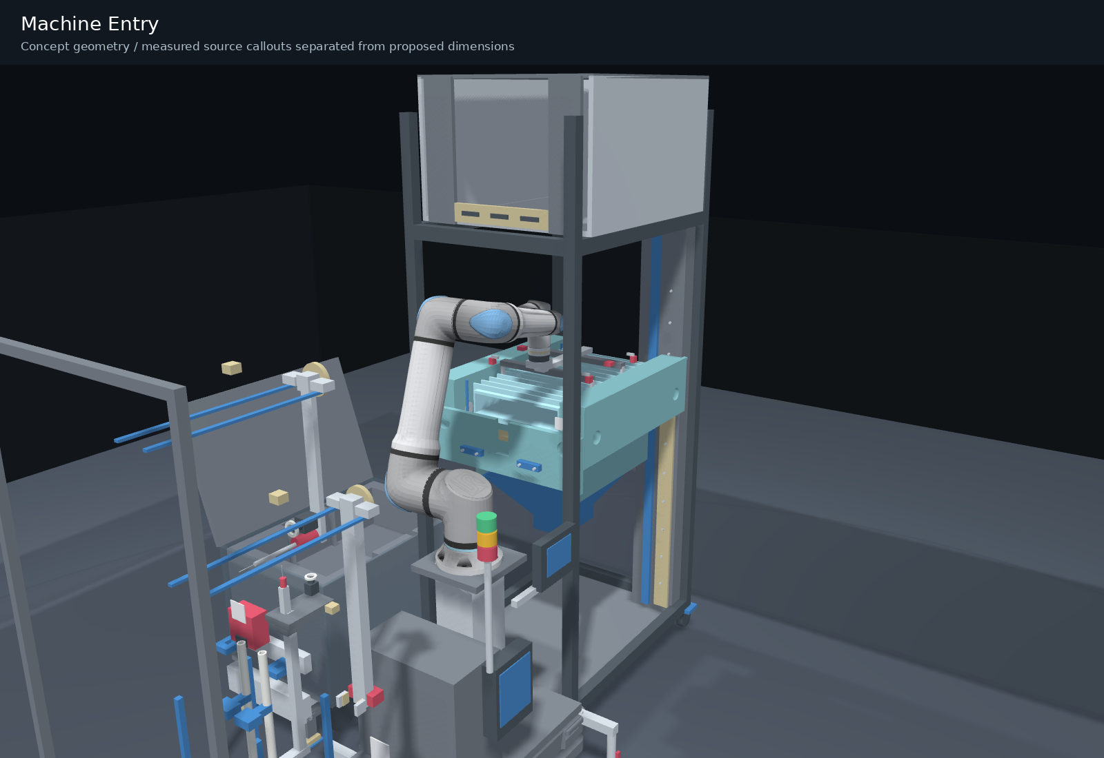
Guide-free level entry and seating
Three holes to three pins
Enter level through the opening, then descend slowly with sensitive force monitoring.
Confirm all three seats
Unload before opening. Two removable guiding fixtures remain an optional comparison.
AETEC / ASM · Revision F · 24 October 2026
08
Notes:
A rigid frame correction cannot repair hole-pattern mismatch. No forced rocking or search. Nominal geometry does not establish insertion accuracy, quartz stress or stopping force.
Source: Information for AETEC_20261023.pptx, all 10 slides reviewed. Latest project instructions define Rev F. Initial concept for discussion. Sensing is simulated.

Slide 9
Operator signals and deliberate recovery
Event | Visible / audible feedback | Control response
Camera capture | Light flash | Capture and quality check
Probe contact | Tip indication and short beep | Record calibrated touch
Three seats confirmed | Green OK light | Unload, open and record
Abnormal force / disagreement | Amber HOLD / red NG | Retain load and stop sequence
Reset / acknowledge | Fault acknowledged | Separate deliberate Start required
Controller and pendant remain at the robot base; the linked PC records the job.
AETEC / ASM · Revision F · 24 October 2026
09
Notes:
All displayed signals and measurements are simulated. Guard/interlock readiness, support loads and displacement, machine reservation and IDs form start conditions.
Source: Information for AETEC_20261023.pptx, all 10 slides reviewed. Latest project instructions define Rev F. Initial concept for discussion. Sensing is simulated.

Slide 10
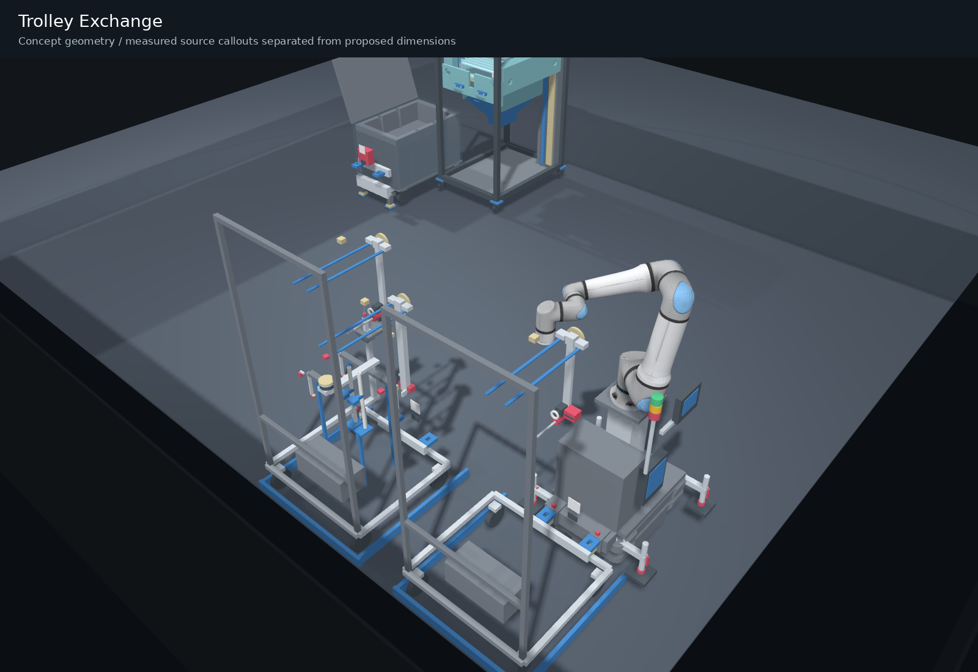
Optional trolley B inspection workflow
Return A → capture B
At the exchange station, support A, release its latch and capture B. Check trolley ID and retention before travel.
Inspect the machine
Use T4 camera, probe and laser triangulation for dimensions, 3D scans and trained defect detection.
AETEC / ASM · Revision F · 24 October 2026
10
Notes:
Custom yaw-locked lift capture is a proposed integration, not a verified OEM Hook plus UR30 configuration. Optical response on transparent quartz and AI defect acceptance require sample trials.
Source: Information for AETEC_20261023.pptx, all 10 slides reviewed. Latest project instructions define Rev F. Initial concept for discussion. Sensing is simulated.

Slide 11
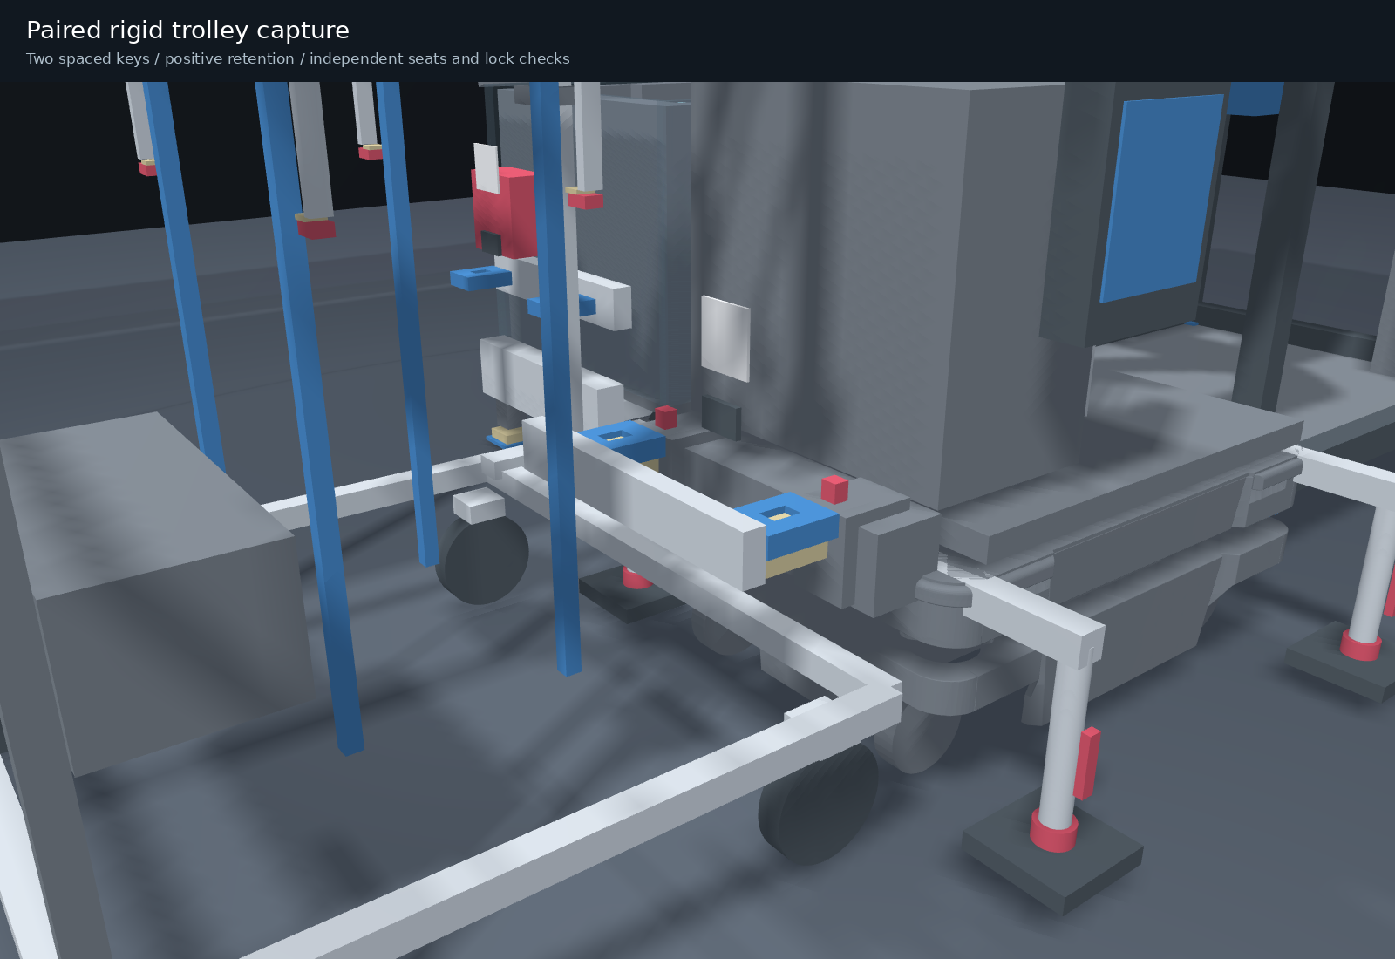
Rigid capture and repeatable docking
Two spaced capture points
A stiff bridge and mechanically retained locks carry separation loads. Datum faces carry shear and constrain the trolley.
AprilTag / RFID identify. Seat and lock sensors verify. Strength and integration approval remain open.
AETEC / ASM · Revision F · 24 October 2026
11
Notes:
Principle reference: MiR250 Hook uses AprilTag for cart identification; SCHUNK form-fit retained clamping illustrates power-loss retention, not a selected or qualified cart coupling. Include braking, turning, fatigue and tolerance in validation.
Source: Information for AETEC_20261023.pptx, all 10 slides reviewed. Latest project instructions define Rev F. Initial concept for discussion. Sensing is simulated.

Slide 12
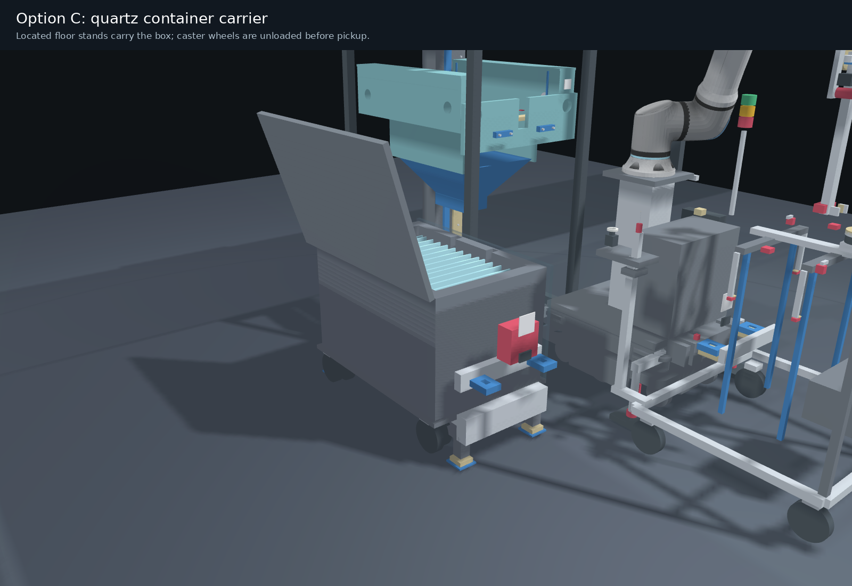
Optional trolley C: transport then floor support
Under-box fork carrier
Capture C, insert below the structural box base, lift and transport. Dock at the pickup floor references.
Jacks transfer load to stands. Confirm wheel clearance and retention before AMR release.
AETEC / ASM · Revision F · 24 October 2026
12
Notes:
Base scope already includes a manually set floor-supported holder and locators. Option C is an incremental powered underlift and transport upgrade, not a duplicate holder. Isolated AMR-supplied24V power, brakes/mechanical retention, load/displacement feedback and safe disconnection require detailed design and tests. No off-the-shelf cleanroom pallet jack is claimed.
Source: Information for AETEC_20261023.pptx, all 10 slides reviewed. Latest project instructions define Rev F. Initial concept for discussion. Sensing is simulated.

Slide 13
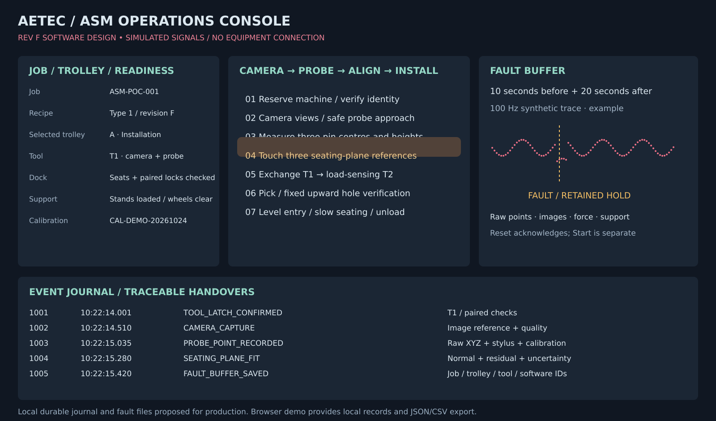
Software interface and fault traceability
Job / trolley / tool / calibration IDs · raw points · images · force and support states
10 s before + 20 s after fault · local persistence · export · no restart on Reset
AETEC / ASM · Revision F · 24 October 2026
13
Notes:
100Hz trace proposal. Browser review implements synthetic traces, local IndexedDB journal and JSON/CSV export; not a production historian or safety controller. Production logging requires synchronized timestamps, integrity, bounded retention, storage failure detection and HOLD where evidence is mandatory.
Source: Information for AETEC_20261023.pptx, all 10 slides reviewed. Latest project instructions define Rev F. Initial concept for discussion. Sensing is simulated.

Slide 14
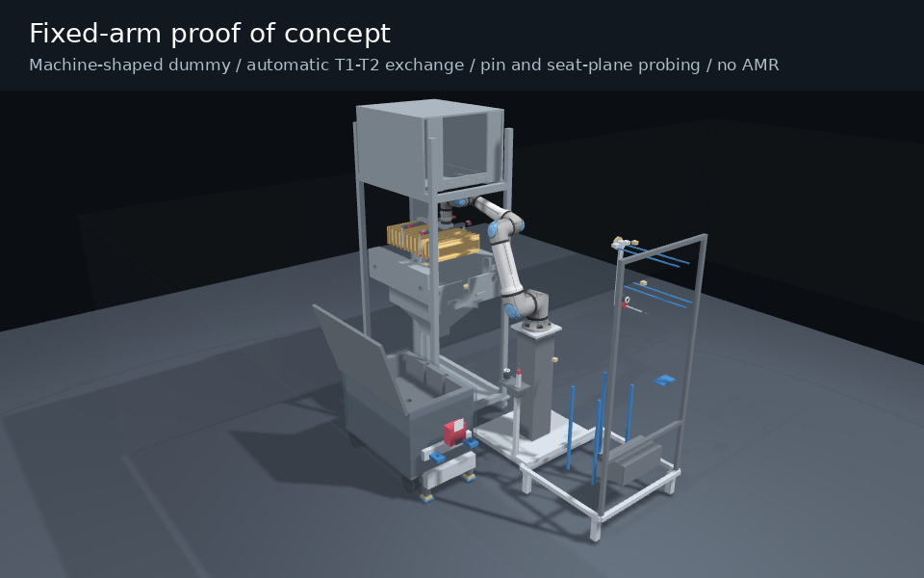
Fixed-arm proof of concept
Machine-shaped dummy and automatic tools
Automatically exchange T1 camera/probe and T2 gripper. Measure three pins and seating surfaces; repeat placement through the dummy machine obstructions.
No AMR in this phase
A printed dummy cannot validate real-quartz fracture limits or production cleanroom behaviour.
AETEC / ASM · Revision F · 24 October 2026
14
Notes:
Proposed100 normal trial cycles after tuning; actual acceptance thresholds must be agreed. Animation is not test evidence. POC excludes robot ownership and production installation.
Source: Information for AETEC_20261023.pptx, all 10 slides reviewed. Latest project instructions define Rev F. Initial concept for discussion. Sensing is simulated.

Slide 15
Budgetary quotation and selectable options
Package | SGD excluding tax
Fixed-arm POC, separate phase | 119,295
MiR250 + UR30 + trolley A base | 625,845
Option: T3 + two removable guides | 22,110
Option: AI inspection trolley B | 140,085
Option: powered container carrier C | 78,210
Base with all three options | 866,250
Budget allowances pending written supplier offers and design freeze.
POC is additional. ROI awaits ASM job frequency, labour and damage/rework data.
AETEC / ASM · Revision F · 24 October 2026
15
Notes:
Commercial model24Oct2026, SGD ex tax. The stated engineering risk allowance is included. Detailed internal costing is maintained separately. POC no incremental robot access alternative106,095. No automatic POC production credit. Public price benchmarks are not supplier quotations.
Source: Information for AETEC_20261023.pptx, all 10 slides reviewed. Latest project instructions define Rev F. Initial concept for discussion. Sensing is simulated.

Slide 16
Nominal path verification
Check | Rev F result
Sampled configurations | 22,417
Unintended mesh contacts | 0
Maximum joint increment | 0.5000 degrees
Narrow-phase mesh tests | 221,261
Fixed upward station motion during measurement | 0.000 mm
Guide-free installation, tool exchange, trolley exchange and inspection
Sampled reconstruction only. Final CAD, cables, tolerances and physical validation remain open.
AETEC / ASM · Revision F · 24 October 2026
16
Notes:
Source collision_report.json, full trajectory and SHA256. No continuous swept-volume proof or functional-safety certification. Separate Rev F reports cover the machine-shaped fixed POC and container transport. T3 guide installation remains outside these guide-free checks.
Source: Information for AETEC_20261023.pptx, all 10 slides reviewed. Latest project instructions define Rev F. Initial concept for discussion. Sensing is simulated.

Slide 17
Engineering release and next phase
Input / gate | Purpose
Final machine and quartz CAD | Confirm source datums, fits, hidden geometry and approved contacts
Mass, CG and force limits | Verify UR wrist load, AMR capacity, stiffness and floor reactions
Manufacturer integration review | Approve UR30 mounting, mobile power and custom lift/latch
Real samples and POC | Measure optics, probing, extraction, seating and recovery
Integrated ISO 7 acceptance | Qualify the complete operating assembly
Operational baseline | Calculate measured cycle benefit and defensible ROI
Approve the POC scope and acceptance criteria before mobile-system commitment.
AETEC / ASM · Revision F · 24 October 2026
17
Notes:
UR30 arm/controllerISO4; MiR250optionalISO4 configuration. Component ratings do not qualify entire assembly. https://mobile-industrial-robots.com/products/robots/mir250/specifications . Exact ASM deposition process remains unconfirmed.
Source: Information for AETEC_20261023.pptx, all 10 slides reviewed. Latest project instructions define Rev F. Initial concept for discussion. Sensing is simulated.

